Slide 1
Statement of Conditions
How to ease the rental process and mitigate potential Tenant/Landlord disputes
Coding & The Law Final Project
Jonathan T. Costello, SULS 2022

Slide 2


The problem & Who is this For?
Notes:
In Massachusetts and many states, apartment renters are required to put forward a security deposit.
This security deposit is returned when the tenant leaves the unit and the unit is in the same condition when the lease was started.
This creates an obvious tension point. In mass. the sec deposit is typically one months rent (in Boston this will typically be $2,200 for a one bed room).
Tenants will try to recover the deposit, and landlords will try to nitpick and find ways to keep the deposit.
The recovery of the deposit is dependent on the condition of the unit at move out compared to the agreed upon condition at lease.

Slide 3
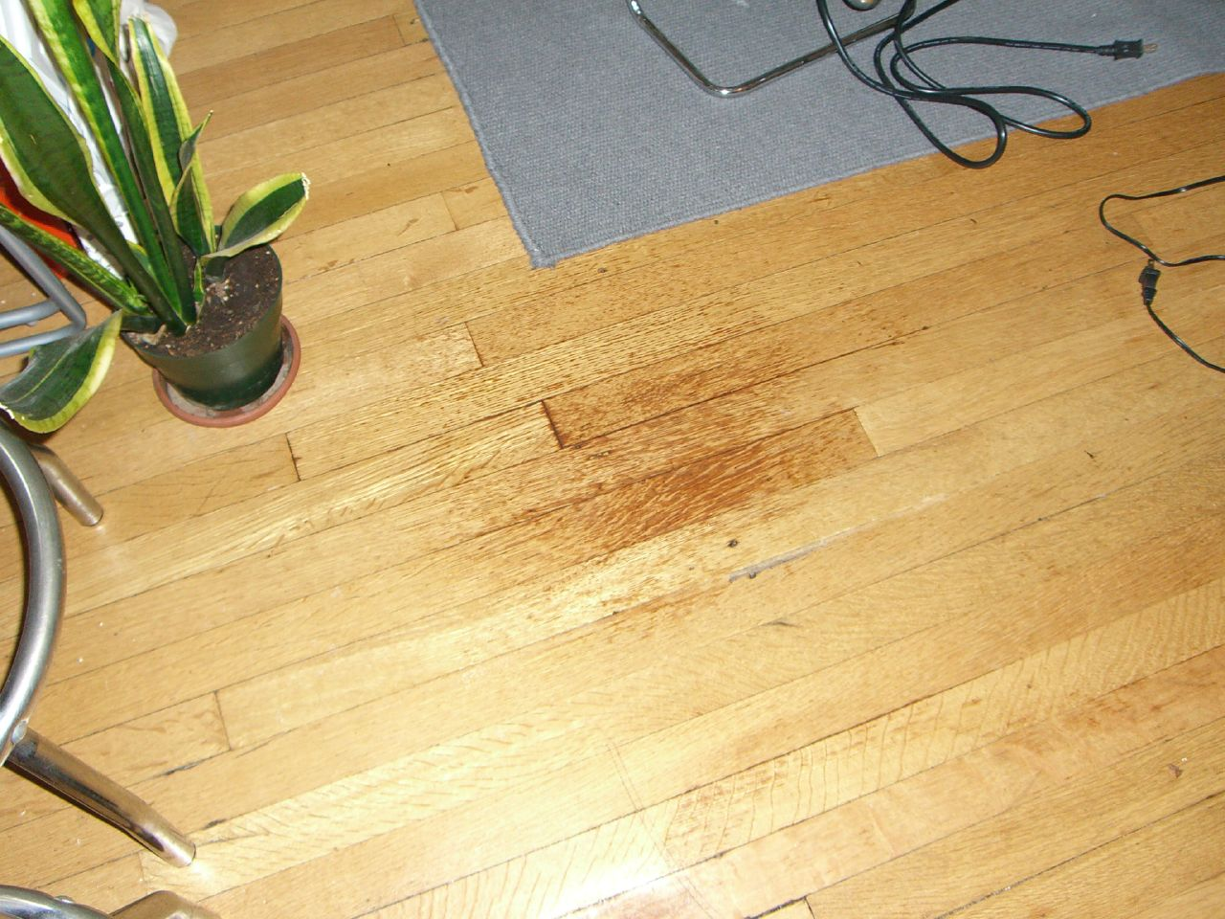
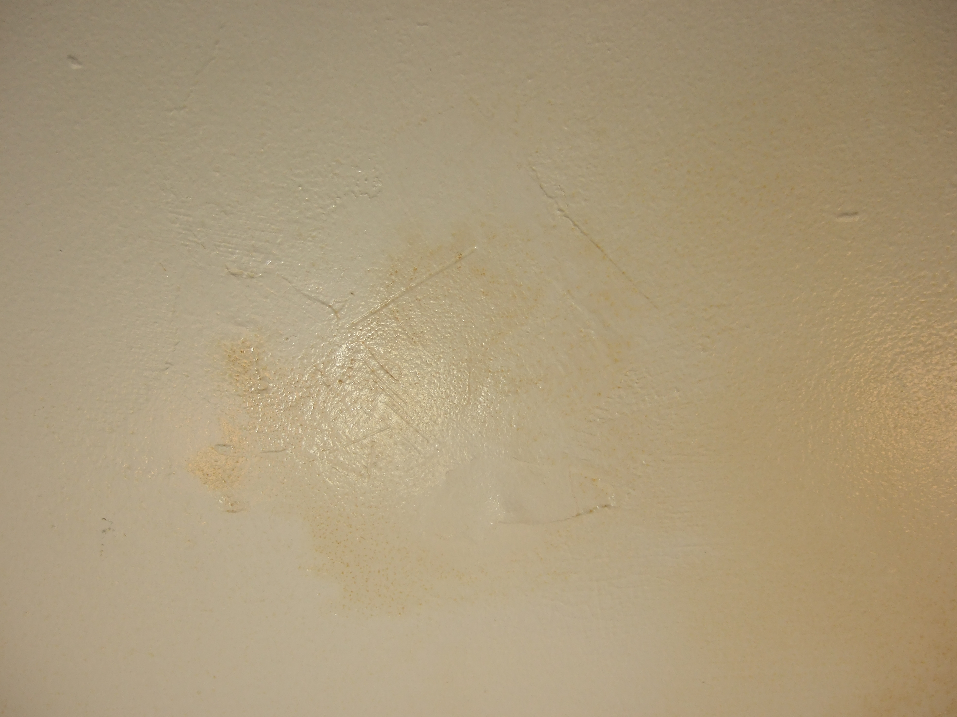
The problem & Who is this For?
Notes:
When these tensions arise, this can lead to civil litigation and in Massachusetts housing court
The software is being developed for Tenants and Landlord to use while performing the initial inspection of the property.
Highest return on rentals tends to come from cheaper/low income rentals. Unfortunately this leaves space for LL to take advantage of the power/economic differential vs students, young, immigrants, etc.
PROBLEMS:
Power/economic disparity (depending on state)
Possible difference in property education/vocabulary
Reduce legal costs, reduce court times
Reduces the risk of breakdown in T/LL relationship due to failure to communicate difference in conditions

Slide 4
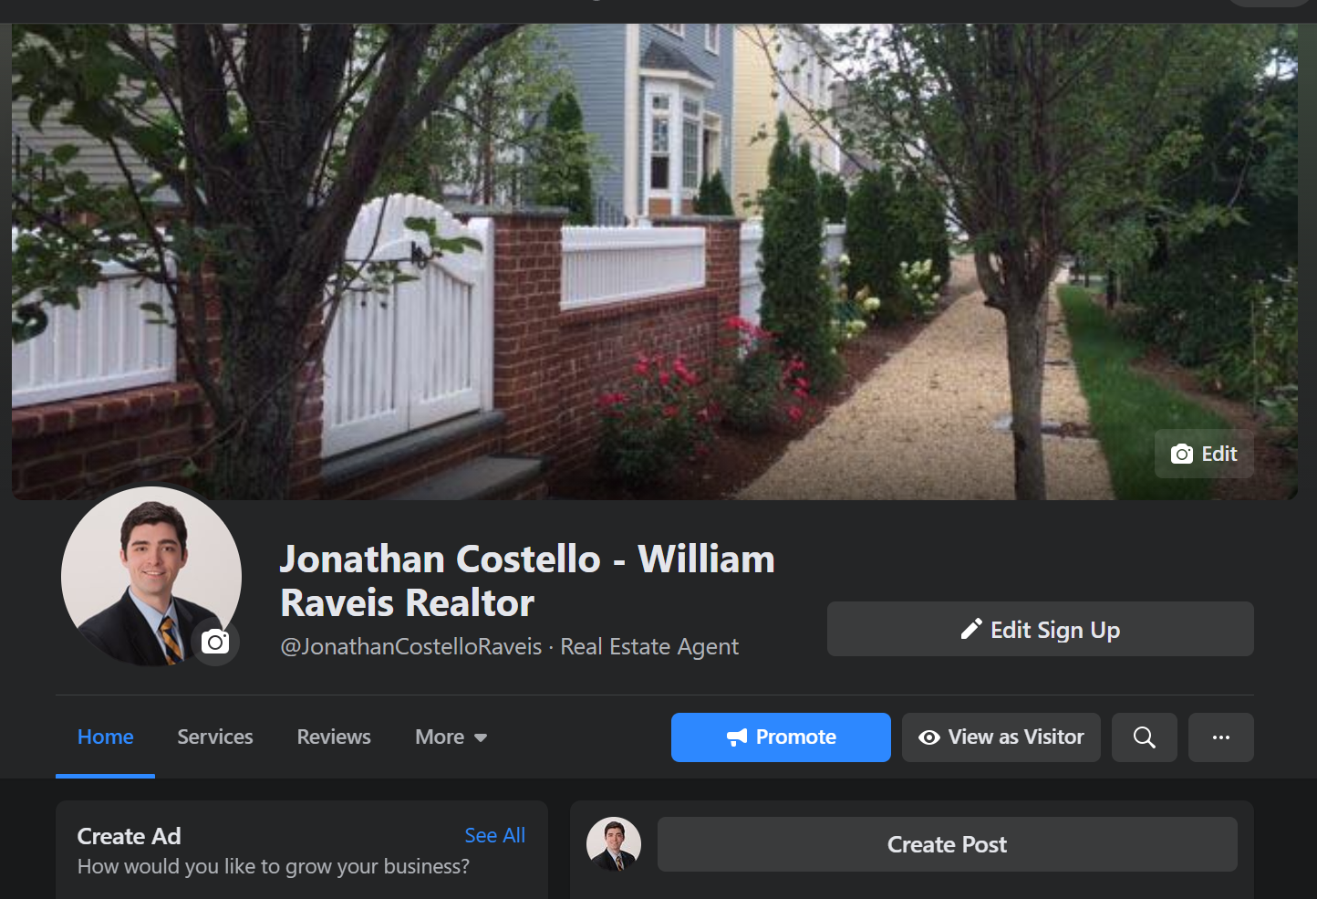
Research
I have many years of experience in the industry.
Experience in real estate sales, development and insurance.
There are few tools that exist currently for LL/Tenant relations and ensuring smooth transitions
Notes:
Experience
-father was dev
I tried to be a dev
Realtor for 4-5 years doing single family homes and rentals
Reached out to some in the realtor community and few tools exist
Anything that does currently exist is likely an in-house solution provided to a realtor or salesperson by their corp office
Currently it most comes down to state by state legislation
Some states are very landlord friends (tax breaks, easy to evict, can legally compel the sale of former tenants assets to satisfy debt)
Some states are much more tenant friends like Massachusetts (after paying several consecutive months of rent, tenants can squat for up to 12 months before being evicted)
Ideally, the process and relationship can be made to be better through the use of transparency and technology
And neither landlord nor tenant will have the circumstance where they will need to take the other to court

Slide 5



Goal
Solution
Notes:
GOAL
-Level the field between Landlord and Tenant through transparency
-Utilize technology to create a comprehensive Statement of Conditions including relevant Mass. Code
-Reduce costs for all parties and state by avoiding legal conflicts and consuming court time
Solution
Working with Docassemble
A transparent automated process that can create a comprehensive list of property conditions with corresponding state housing codes
The program will create a PDF that can be sent to the LL and Tenant which will have listed all violations, appropriate codes, and (when applicable) a days remaining that are required until the issue is resolved
- Distance goal: Have a way to upload photos documenting code violations that can be included in pdf

Slide 6

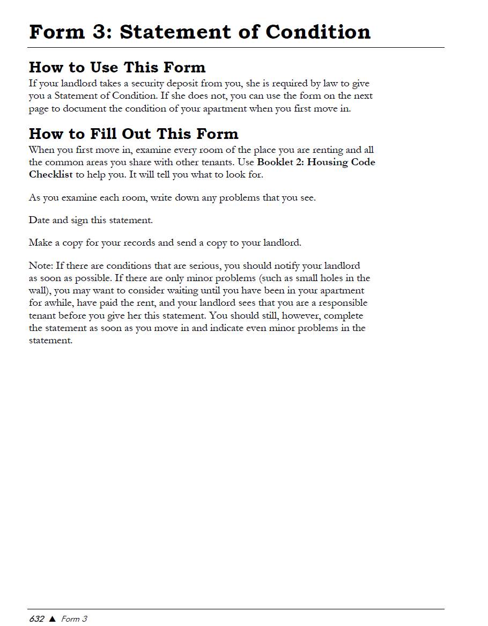
The Form
The Statement of Condition SoC form is very spartan
Notes:
Forms and checklists from MassLegalHelp

Slide 7
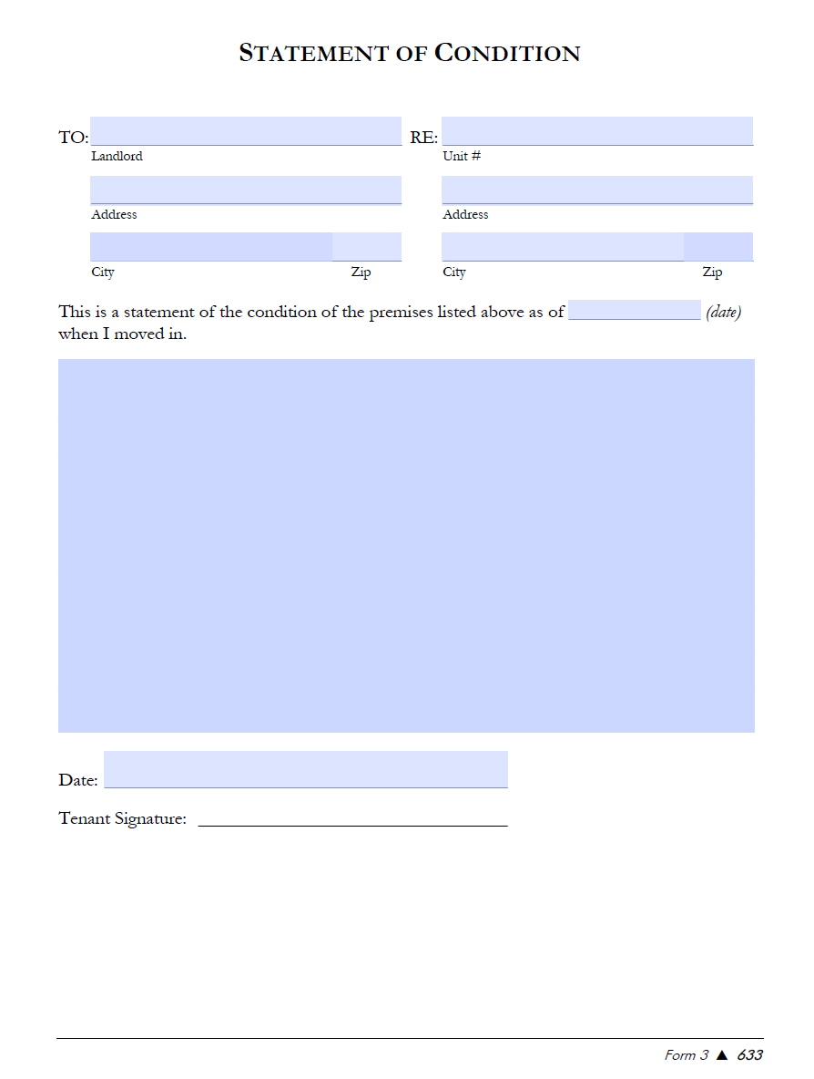
Notes:
This is the general Statement of Conditions form
Requirements:
- Name, date, address and blank fill in space for any issues encountered
Most people will just write that all is good and sign it.
The form needs details –

Slide 8


Notes:
If anyone has seen the recent Netflix series – dirty money – you can imagine how there will be natural tension between landlord and tenant.
Some landlords are fair and treat their tenants well. Many states help by having Tenant friendly legislation (like Massachusetts).
However, the ambiguity of the Statement of condition form allows for this tension to grow.
Many tenants do not take it serious, do not fully understand what it is, and do not thoroughly complete the form. Move in day is an exciting day and the last thing you want to do is go through your unit with a fine tooth comb to determine if your landlord might be in violation of an obscure housing code

Slide 9
Compiling Data for a comprehensive SOC
Move-In Checklist
Housing Code Checklist
Key Points:
Utilities
Move in Date
Current Vacancy?
Planned repairs
Lead paint
Different Codes have different urgency timelines
24 Hours or less
5 Days or Less
30 Days or Less
Provides Mass Housing Codes that correspond with Checklist items
Notes:
Both are very similar. My goal is to create a comprehensive tool that will allow tenants to move through the physical space and document any damages they see or code violations.
This will subsequently produce a line-item with the corresponding code violation and urgency of repairs

Slide 10
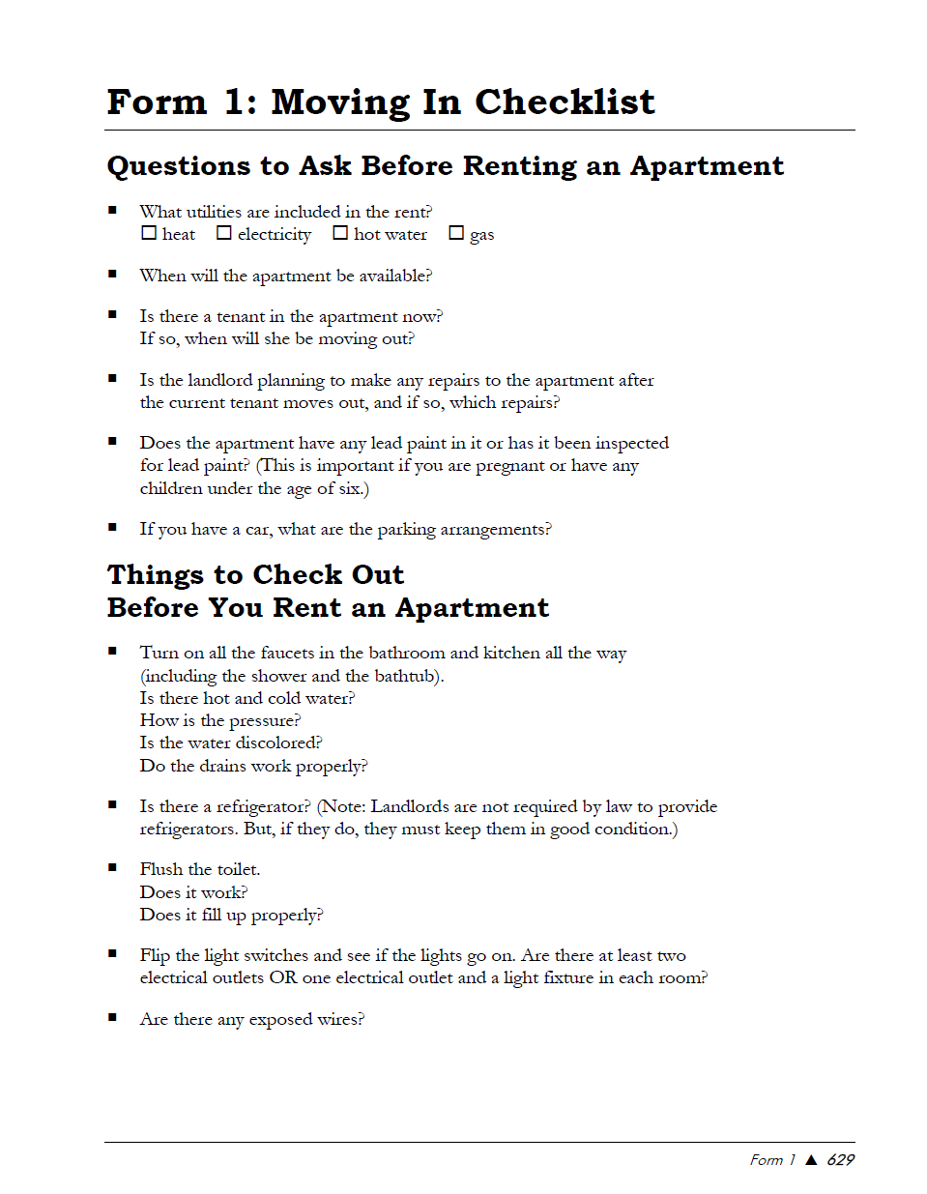
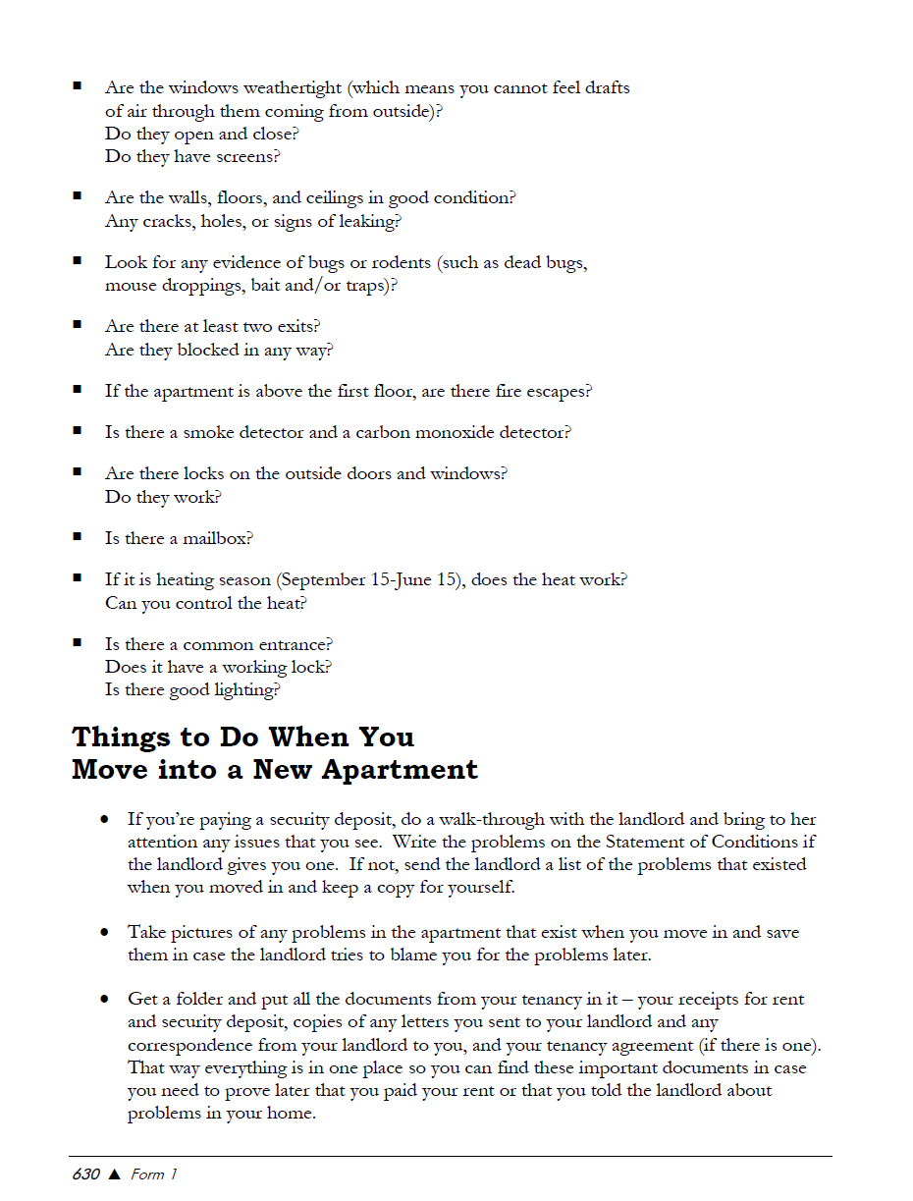

Move-In Check List

Slide 11
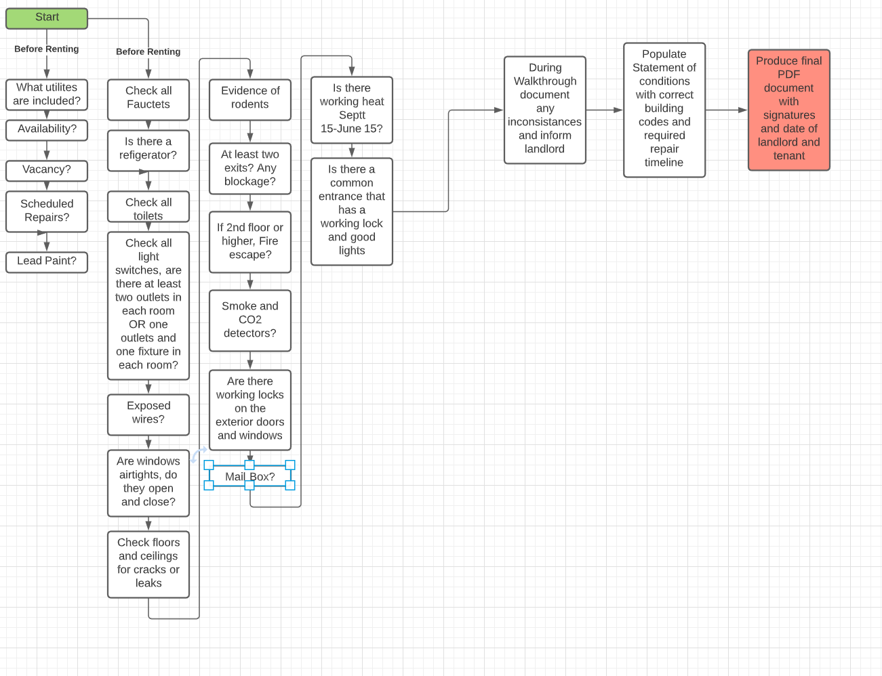
Approach
Notes:
Ive started by framing the move in checklist and house codes into flow charts

Slide 12
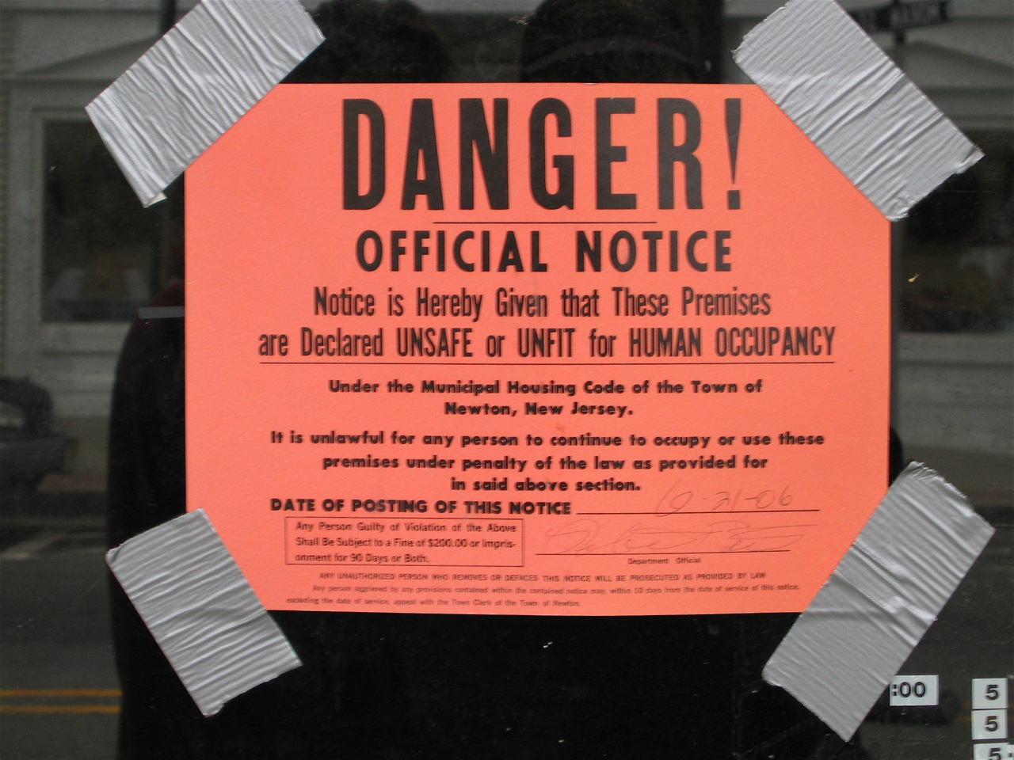
Housing Code Issues
Broken into different categories
Urgency of Repair
Room
Utilities
Type
Notes:
Urgency: as mentioned before
Room: Kitchen and Bathroom and garage
Utilities: Water, heat electricity and gas
Type: Ventilation and light, space.
Maintenance/safety: lead paint, rodents/insects, garbage, structural maintenance, general maintenance and safety codes

Slide 13
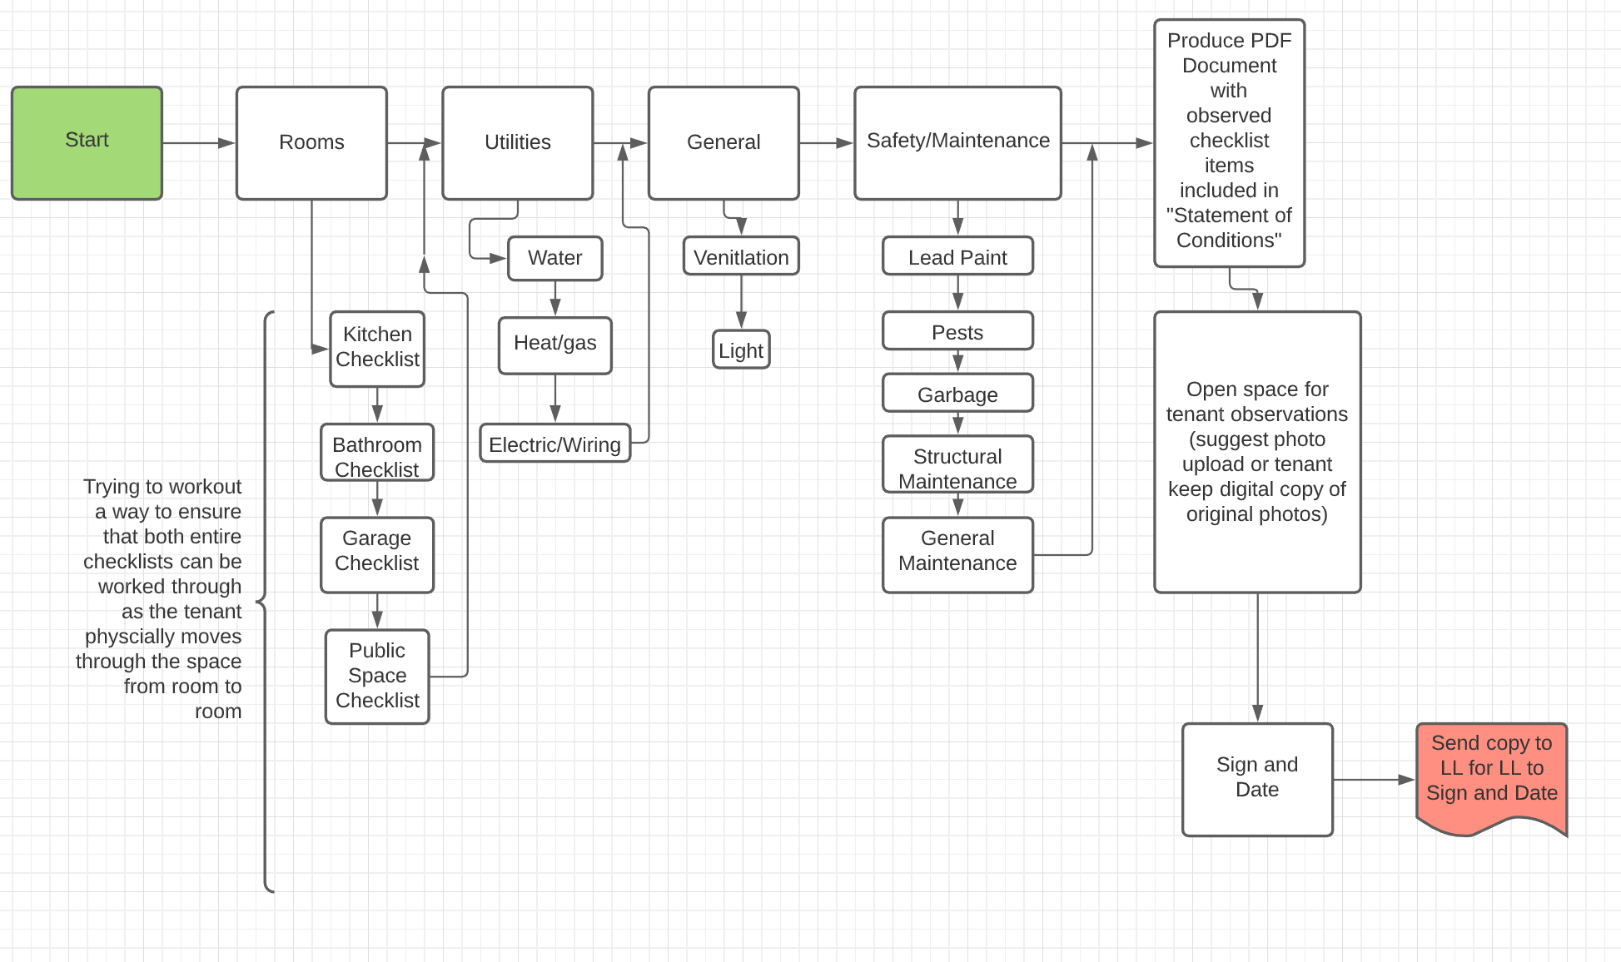
Approach
Notes:
Housing code flow chart
As you can see the two charts and question processes are very similar
Each of the sub categories have additional questions (most are either T/F questions or multi choice)

Slide 14
Next Steps
Next steps will be
Prototyping
Map a smooth connection between the move-in checklist and housing codes
Map a smooth flow so that tenant/LL can fill form as they physical move through the space.
Want to avoid backtracking
Coding
Begin coding once plan is formalized
Testing
Have friends and peers use the tool to walk and document through their own apartments/Condos
Likely highlighting any issues with vocabulary, special flow, and faults in the code
Refinement
Utilize my own test and feedback from peers to refine and correct and issues with current iteration of software

Slide 15
Pre-Mortem Self Assessment of possible issues
Possible Issues
Difference in descriptions. (Slide 3 – is that cosmetic or is that damage?)
English as a second language
Lack of building terminology fluency
Potential for program to seem long/boring/overwhelming
LL may refuse to agree to use program
Program helps level playing field and in a busy market like Boston area, LL may simply refuse to rent to tenant and rent to someone more compliant

Slide 16
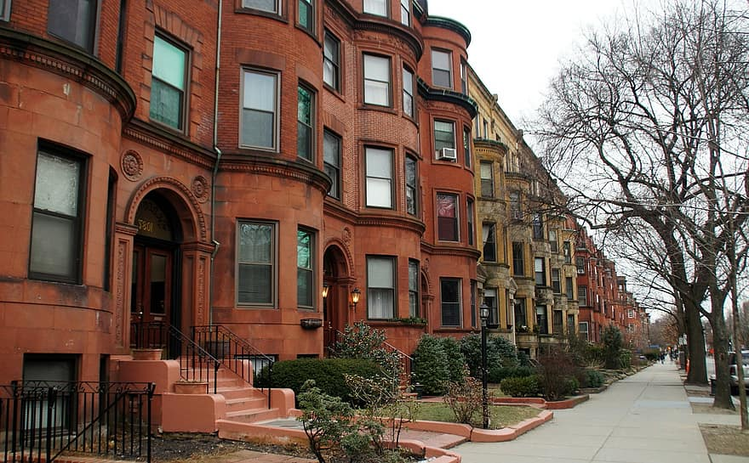
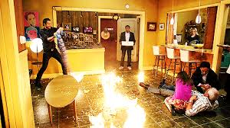
Q&A

